Slide 1

SMART POULTRY FARM CONTROL SYSTEM
Batch No.4
Team members
1. Shreedhar G(411723106078)
2. Manoj S(411723106051)

Slide 2

Objective of the Project
To develop an automatic poultry farm temperature control system.
To monitor temperature and humidity using DHT11 sensor.
To control heater automatically during cold conditions.
To control intake and exhaust fans during high temperature.
To reduce manual monitoring and improve poultry health.

Slide 3


PROBLEM STATEMENT
Poultry birds are sensitive to temperature variations.
Temperature drops significantly during winter nights.
Manual monitoring is difficult and time-consuming.
Delayed response causes stress and disease in birds.
An automated temperature control system is required.

Slide 4
EXISTING SYSTEM
Traditional poultry farms use manual monitoring.
Farmers manually operate heaters and fans.
Continuous supervision is required.
Higher labor cost.
Delayed response during sudden temperature changes.
Reduced efficiency and productivity.

Slide 5
NOVELTY
Automatic temperature monitoring.
Real-time environmental control.
Automatic heater operation during cold weather.
Automatic intake and exhaust fan control.
Energy-efficient operation.
Low-cost Arduino-based solution.

Slide 6
PROPOSED SYSTEM
DHT11 continuously monitors temperature and humidity.
Arduino Uno processes sensor data.
Relay module controls heater and fans.
Heater activates when temperature falls below threshold.
Fans activate when temperature exceeds threshold.
Maintains comfortable poultry farm environment automatically.

Slide 7
Literature Survey –1 (BASE PAPER IEEE)
TITLE OF THE PAPER | AUTHOR | YEAR OF PUBLICATION | METHOD/ TECHNIQUE | INFERENCE
Arduino-Based Smart Poultry Farm Temperature Monitoring and Control System | Kumar R., Sharma P., Verma S. | 2023 | Arduino Uno, Temperature Sensor, Relay Module, Automatic Heater and Fan Control | The system automatically monitors temperature and controls heating and cooling devices, improving poultry health, reducing manual labor, and maintaining a stable environment inside the poultry farm.
This paper proposes an Arduino-based poultry farm monitoring system that continuously measures temperature and automatically controls heaters and fans. The system helps maintain optimal environmental conditions, reduces human intervention, and improves poultry productivity.

Slide 8
Literature Survey–2 (REFERENCE PAPER)
TITLE OF THE PAPER | AUTHOR | YEAR OF PUBLICATION | METHOD/ TECHNIQUE | INFERENCE
IoT-Based Smart Poultry Farm Environmental Monitoring System Using Sensors and Cloud Computing | Singh A., Patel M., Gupta R. | 2022 | IoT, Temperature Sensor, Humidity Sensor, Cloud Monitoring, Wi-Fi Communication | The system enables remote monitoring of poultry farm conditions through cloud technology and improves environmental management using real-time sensor data.
This paper presents an IoT-based poultry farm monitoring system that collects environmental data using multiple sensors and transmits it to the cloud. Farmers can monitor farm conditions remotely and receive alerts when environmental parameters exceed safe limits.

Slide 9
Literature Survey – 3 (REFERENCE PAPER)
TITLE OF THE PAPER | AUTHOR | YEAR OF PUBLICATION | METHOD/ TECHNIQUE | INFERENCE
Arduino-Based Automated Temperature Control System for Poultry Farms Using Sensors and Relays | Kumar S., Patel R. | 2021 | Arduino Microcontroller, Temperature Sensor, Relay-Based Heater and Fan Control | The automated system maintains a stable temperature inside the poultry shed, reducing poultry stress and improving bird growth and health.
This paper focuses on automatic temperature regulation in poultry farms using an Arduino controller and relay modules. The system activates heaters and fans based on temperature conditions, ensuring a comfortable environment for poultry birds with minimal human intervention.

Slide 10
Literature Survey – 4 (REFERENCE PAPER)
TITLE OF THE PAPER | AUTHOR | YEAR OF PUBLICATION | METHOD/ TECHNIQUE | INFERENCE
Wireless Sensor Network Based Smart Poultry Farm Monitoring System for Environmental Control | Rahman M., Islam T., Ahmed N. | 2021 | Wireless Sensor Network (WSN), Environmental Sensors, Central Control Unit | The system improves environmental monitoring accuracy by collecting data from multiple sensor nodes and enables better poultry farm management.
This paper presents a Wireless Sensor Network (WSN) based poultry farm monitoring system that uses distributed sensors to measure environmental conditions. The system improves monitoring accuracy, provides real-time environmental control, and enhances poultry health and productivity.

Slide 11
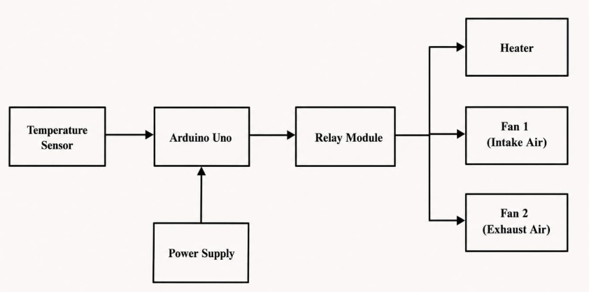
Block diagram

Slide 12
Hardware Requirements
Hardware Components Used:
Arduino Uno
DHT11 Temperature and Humidity Sensor
2-Channel Relay Module
Heater
Fan 1-Air In
Fan 2-Air Out
Jumper Wires
Breadboard / PCB
Power Supply Unit
Description
The hardware setup consists of an Arduino Uno microcontroller that acts as the central controller of the system. The DHT11 sensor continuously monitors temperature and humidity inside the poultry shed. Based on the sensor readings, the Arduino controls the heater, intake fan, and exhaust fan through a 2-channel relay module. The heater maintains warmth during cold conditions, while the intake and exhaust fans provide proper ventilation and temperature regulation. The entire system is powered using a regulated power supply for reliable operation.

Slide 13
Software Requirements
Arduino IDE:
Arduino IDE is the software used to write, compile, and upload programs to the Arduino Uno microcontroller. It provides a simple and user-friendly environment for developing embedded applications. In this project, Arduino IDE is used to develop the control program that reads temperature and humidity data from the DHT11 sensor and controls the heater, Intake fan, and exhaust fan through relay modules.
Embedded C:
Embedded C is the programming language used to implement the control logic of the Smart Poultry Farm Control System. It enables the Arduino Uno to continuously monitor sensor readings, compare them with predefined threshold values, and automatically operate the connected devices. Embedded C provides efficient, reliable, and real-time control, making it suitable for automation applications in poultry farming.

Slide 14
Conclusion
The Smart Poultry Farm Control System was successfully designed and implemented using Arduino Uno, DHT11 sensor, relay module, heater, intake fan, and exhaust fan. The system continuously monitors temperature and humidity conditions and automatically controls the connected devices to maintain a suitable environment inside the poultry shed.
The experimental results demonstrated that the system effectively regulates temperature, reduces manual monitoring efforts, improves energy efficiency, and enhances poultry health and productivity. The proposed system provides a simple, reliable, and cost-effective solution for modern poultry farm automation and can be further enhanced with IoT-based remote monitoring and advanced environmental sensing features.

Slide 15
THANK YOU

